Slide 1

Basics of choice theory
Dr.R.Gayathri
Faculty ,SoM, SASTRA

Slide 2
Understanding Utility
A customer is the one who usually determines his demand for goods based on the satisfaction (utility) that he procures from them.
In Economics: The satisfaction or benefit derived from consuming goods or services.
In Psychology: The subjective value or emotional impact a decision has on an individual.
The simple meaning of ‘utility’ is ‘usefulness’. In economics utility is the capacity of a commodity to satisfy human wants.

Slide 3
A few statements on utility..,
Utility is not Usefulness
Utility has no Ethical or Moral Significance
Utility is Psychological
Utility is always Individual and Relative
Utility cannot be Measured Objectively
Utility Depends on the Intensity of Want

Slide 4
Forms of utility
Form
Place
Time
Service

Slide 5
Types of utility
Marginal Utility- Marginal utility is the utility derived from the last or marginal unit of consumption. It refers to the additional utility derived from an extra unit of the given commodity purchased, acquired or consumed by the consumer.
Total Utility - Total Utility is the utility from all units of consumption.
Average Utility -Average Utility is that utility in which the total unit of consumption of goods is divided by the number of Total Units.

Slide 6
Measurement of utility – Cardinal & Ordinal
Cardinal utility
Definition: Measures satisfaction or pleasure from a product using numbers, called "utils"
Assumptions: Utility is measurable and can be expressed in units of utility
Applications: Welfare economics, marginalism, intertemporal utility
Theory developer: Alfred Marshall

Slide 7
Ordinal utility
Definition: Ranks satisfaction with goods, but doesn't assign numbers to that satisfaction
Assumptions: Utility cannot be expressed in numbers
Applications: Understanding individual preferences in decision-making
Theory developers: Hicks and Allen

Slide 8

Utility 2 Decision Utility
A utility function allows a more efficient process of simply selecting the product with the highest utility rather than making comparisons.

Slide 9
Let’s think..
Imagine that you have just completed a graduate degree in communications and you are considering one-year jobs at two different magazines.
1. At Magazine A, you are offered a job paying $35,000. However, the other
workers who have the same training and experience as you do are making
$38,000.
2. At Magazine B, you are offered a job paying $33,000. However, the other
workers who have the same training and experience as you do are making
$30,000.

Slide 10

Experienced Utility and Decision Utility
Experienced utility is a person's subjective experience of an activity, while decision utility is the perceived usefulness of an outcome in a decision

Slide 11
Trending terms in Utility
Remembered utility is measured using a memory-based approach; this involves a retrospective evaluation of past experience.
Real-time utility is measured using a moment-based approach; this is a more difficult procedure to implement since it involves continuously monitoring the subjects.
For example, in the colonoscopy studies the subjects were asked to rate their pain on a scale of 0 (no pain at all) to 10 (intolerable pain) every 60 seconds.

Slide 12
Thaler proposes instead that there are two types of utility that consumers gain from a transaction:
1 Acquisition utility – this represents the value of the good obtained relative to its price, equivalent to the concept of consumer surplus.
2 Transaction utility – this corresponds to the perceived value of the ‘deal’, in other words, the difference between the reference price and the price paid.

Slide 13
What is Consumer Surplus?
Alfred Marshall, defines consumer's surplus as follows: “The excess of the price which a person would be willing to pay rather than go without the thing, over that which he actually does pay is the economic measure of this surplus of satisfaction. It may be called Consumer surplus”.

Slide 14
Consumer Surplus
Y
Supply
Price
Consumer surplus
E
Producers' surplus
Demand
Quantity
X

Slide 15
The Standard Model
The Standard Economic Model (SEM) is a fundamental framework in economics, which assumes that individuals are rational, self-interested, and utility-maximizing agents. It assumes that people have complete information about their preferences, the available options, and the consequences of their choices.
Sometimes ‘decisions’ do not really appear to be decisions at all because we act on instinct, without conscious thought.

Slide 16
1. Preferences – these are the rankings people have over a set of options or gambles that are based on attitudes and values related to the outcomes of these options .
2 Beliefs – these relate to the probabilities with which people think various outcomes will occur, conditional on available information
3 Rationality – this involves all four components of the standard model, referring to the ways in which people:
determine preferences based on attitudes and values
appropriately modify their beliefs in the light of new information
discount values of future outcomes
succeed in choosing optimal actions given their preferences and beliefs

Slide 17
Revealed Preference theory
Revealed preference, a theory offered by American economist Paul Anthony Samuelson in 1938, states that consumer behavior, if their income and the item's price are held constant, is the best indicator of their preferences.

Slide 18
Indifference curve
The theory of consumer choice is often illustrated using a graphical approach involving indifference curves. An indifference curve represents different combinations of two goods between which the consumer is indifferent, i.e. which yields the same total utility

Slide 19
Indifference curve ..,
An indifference curve, with respect to two commodities, is a graph showing those combinations of the two commodities that leave the consumer equally well off or equally satisfied—hence indifferent—in having any combination on the curve.
This gives the consumer an opportunity to substitute one commodity to another.

Slide 20
Indifference schedule
Combinations | Units of X | Units of Y
1 | 3 | 21
2 | 4 | 15
3 | 5 | 11
4 | 6 | 8
5 | 7 | 6

Slide 21
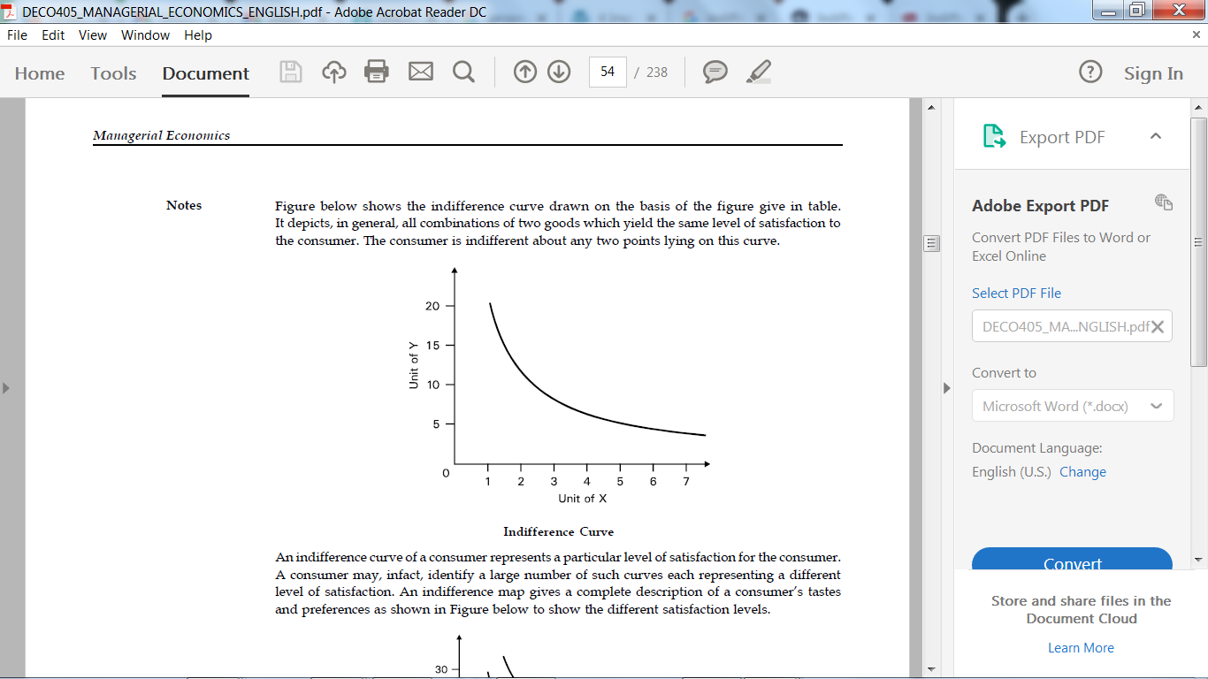
Indifference curve
An Indifference Curve is the set of all baskets for which the consumer is indifferent
The standard model relating to consumer preferences uses the analytical framework of indifference curves and budget constraints.

Slide 22

Neuroeconomics
Neuroeconomics aims to reveal the brain functions that cause individual economic behavior by utilizing neuroscientific methods and to create new economic theories that better explain real economic behavior.

Slide 23

Decision making based on reward
Pavlov (Ivan Petrovich Pavlov 1849–1936), a Russian physiologist, found that the dogs produced saliva immediately after hearing the sound of a bell, when the researcher repeatedly trained them to receive food after the bell sound (so-called Pavolov’s dog). The phenonomenon is termed “classical conditioning.”

Slide 24
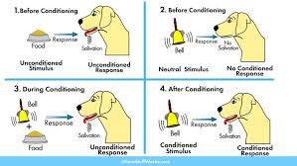

Slide 25

Neuroeconomics: Bridging Utility, Biology, and Neuroscience
Neuroeconomics integrates insights from neuroscience, psychology, and economics to understand utility in decision-making.
Tools to Study Utility in the Brain
fMRI (Functional Magnetic Resonance Imaging):
Identifies brain regions active during utility evaluation and decision-making.
EEG (Electroencephalography):
Tracks real-time neural activity linked to reward and utility computation.
TMS (Transcranial Magnetic Stimulation):
Examines the causal role of specific brain areas in decision-making.

Slide 26

Instrumental conditioning
Thorndike (1911) at Columbia University found that cats learn by trial and error that pushing a lever allowed them to leave the cage, and the time of their response got shortened as they repeat this experiment. This was called “instrumental conditioning.”

Slide 27
Reward / Incentive
Skinner at Harvard University formularized a series of experiments in conditioning, defining a reward as something to reinforce the cooperation of a stimulus and response, and something to increase the probability of causing the response. Psychologists call it a “reinforcer.” Thus, the meaning of reward is almost the same as the meaning of “incentive” in economic terms.

Slide 28
Implications of Neuroscientific Utility Research
Behavioral Economics: Insights into irrational choices, such as loss aversion or framing effects.
Mental Health: Utility deficits in conditions like depression (reduced reward sensitivity) or addiction (overvaluation of short-term rewards).
Marketing and Consumer Behavior: Understanding how the brain perceives product value and brand loyalty.

Slide 29

The neuroscientific basis of utility
The neuroscientific basis of utility explores how the brain encodes, evaluates, and processes utility—the measure of satisfaction, value, or reward derived from choices or actions.

Slide 30

Neural correlates of Utility
Several brain regions are involved in evaluating and representing utility
Ventromedial Prefrontal Cortex (vmPFC) Role: Encodes subjective value or utility of options during decision-making.
Function: Integrates sensory, emotional, and cognitive inputs to assess the value of rewards.

Slide 31

Neurotransmitter Systems in Utility
Ex. Dopamine
Role: Central to reward prediction, learning, and utility assessment.
Function: Encodes reward prediction errors (the difference between expected and received rewards), driving changes in behavior.

Slide 32
Reward and Utility: Subjective Valuation
Utility as a Construct of Subjective Value
Neuroscience supports the notion that utility is inherently subjective, shaped by individual preferences, emotions, and experiences. Ex. MRI Bain scanning

Slide 33
Temporal Utility: The Neuroscience of Discounting
Temporal utility refers to how value diminishes over time (e.g., choosing $10 now versus $15 in a week).
Impulsivity is linked to stronger activation of immediate-reward circuits, while self-control relies on the regulatory role.

Slide 34

Social Utility and the Brain
Social utility (value derived from social interactions) is mediated by:
vmPFC: Integrates social preferences and outcomes.
Anterior Cingulate Cortex (ACC): Processes fairness and social reward.
Example: In the Ultimatum Game, unfair offers activate the insula (negative emotional response), leading to rejection even when it’s against monetary self-interest.

Slide 35

Utility Learning: Reinforcement Mechanisms
The brain learns utility through:
Reinforcement Learning: Trial-and-error updates of value based on reward feedback, driven by dopamine signalling.
Prediction Errors: The brain updates expectations when outcomes differ from predictions, encoded by midbrain dopaminergic neurons.

Slide 36
Hormonal Influences
Hormones influence utility by affecting reward sensitivity, motivation, and social behaviors:
Dopamine: Modulates the reward system and utility encoding.
Oxytocin: Enhances social utility, trust, and cooperation.
Cortisol: Impacts risk-taking and decision-making under stress.
Endorphins: Increase the perceived utility of pleasurable activities, like exercise or social interactions.

Slide 37
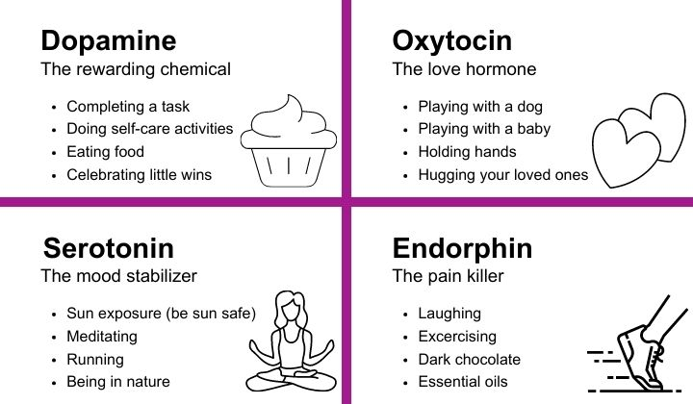

Slide 38
Happiness chemicals
Here are the main happiness chemicals in your body:
Endorphins Primarily helps one deal with stress and reduce feelings of pain
Serotonin Mood stabiliser – wellbeing, happiness
Dopamine Pleasure – Motivational role in brain’s reward system
Oxytocin Bonding – Love and trust

Slide 40


